Slide 1
Analysis of tensile properties in a prepreg platelet molded composite system
Sergey Kravchenko, PhD
Postdoctoral Researcher
Composites Manufacturing & Simulation Center
Purdue University

Slide 2

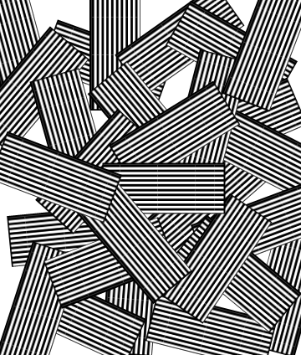

Performance Analysis
& Understanding of structure-property relationship
w_{p}
Computational Damage Mechanics
2
L_{p}
Performance
t_{p}
Theoretical
1
Properties
x₂
x₃
Structure
Analysis
Processing
Experimental
x₁

Slide 3
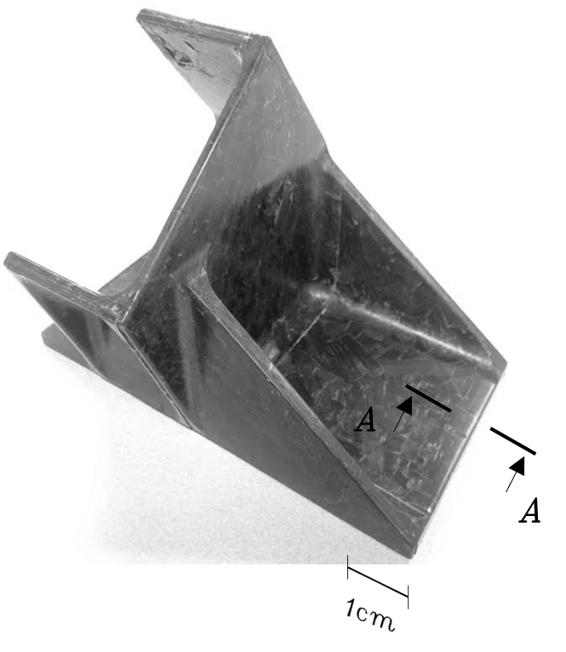
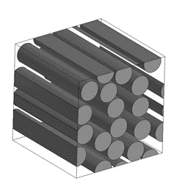
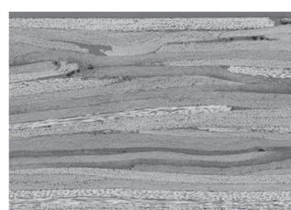
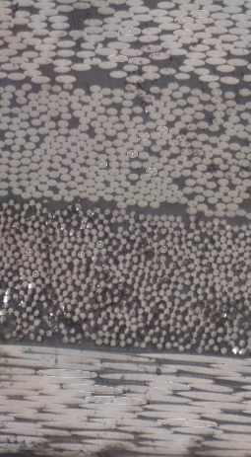
Hierarchical subordination in a prepreg molded composite system
1 mm
A-A
Individual
fibers
20 μm
Individual platelets
Semi-laminated structure of a platelet-stacked composite system
100 μm
Macro-scale
Meso-scale
Micro-scale
Macro-scale effective properties
Complex meso-scale interactions between large number of platelets
Composite meso-structure

Slide 4
Meso-structure descriptors & characteristics

Slide 5

Descriptors and characteristics of the platelet composite meso-structure
Geometrical Arrangement/ Overlapping
Orientation State
Platelets Count
w_{p}
2
Composite System
of Platelets
L_{p}
Platelet Geometry
Composite Morphology
t_{p}
x₂
1
x₃
Complex System
Highly Redundant Structure
Structure of a Composite System
Effective
Properties & Variability
x₁

Slide 6
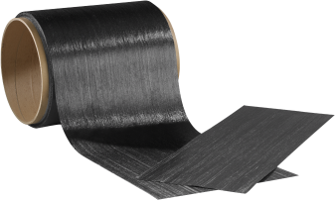
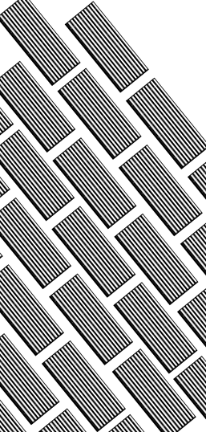
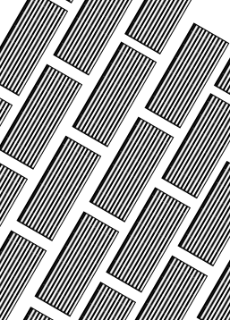
Orientation state in a platelet composite system: stochastic or deterministic
Uncontrolled Irregular Morphology
x₃
x₂
Platelet System with
Stochastic Orientation State
Improved
Hierarchical
Organization
of
Composite
Structure
x₁
Precursor CF Tape
Platelet System with Deterministic Orientation State
x₃
x₂
Engineered/Semi-Controlled Morphology
x₁

Slide 7
Implications of structure descriptors for composite performance characteristics
Variability of morphology descriptors
Variability
of Effective Properties
Platelets Count
Internal redundancy of composite system
Geometrical Arrangement/ Overlapping
Effective Properties
Efficiency of load transfer (stress sharing)
Platelet Geometry
Orientation State
Orthotropic mechanical properties of a platelet are a function of orientation

Slide 8
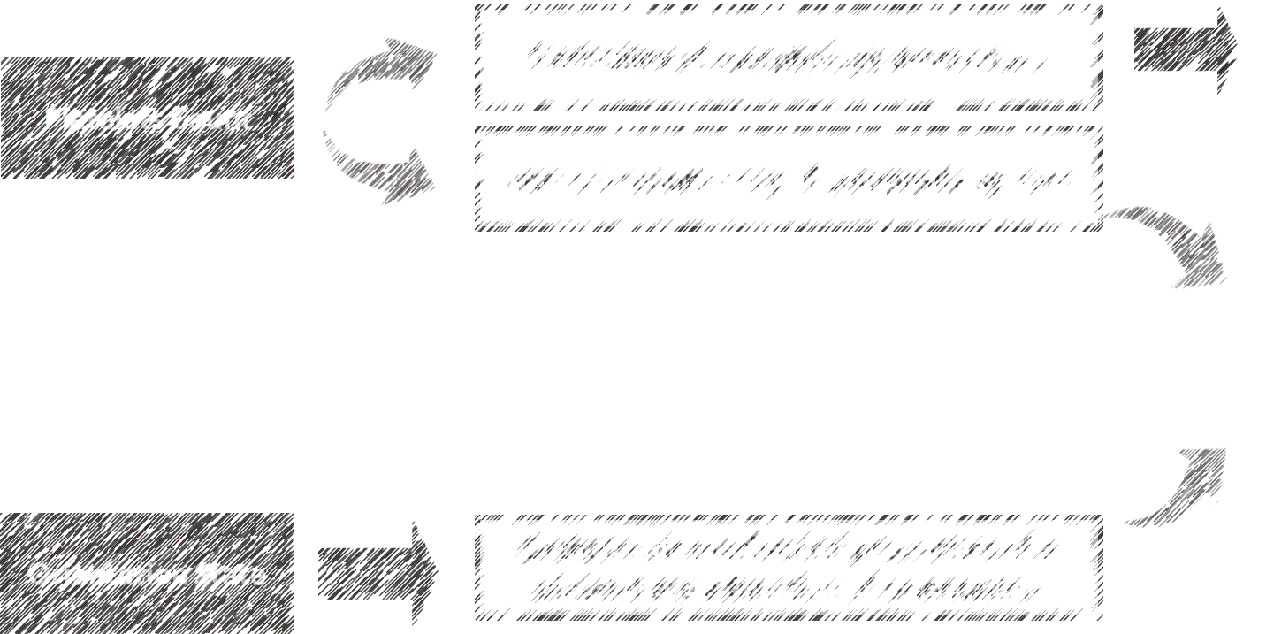
Implications of structure descriptors for composite performance characteristics
Variability
of Effective Properties
Geometrical Arrangement/ Overlapping
Effective Properties
Efficiency of load transfer (stress sharing)
Platelet Geometry

Slide 9
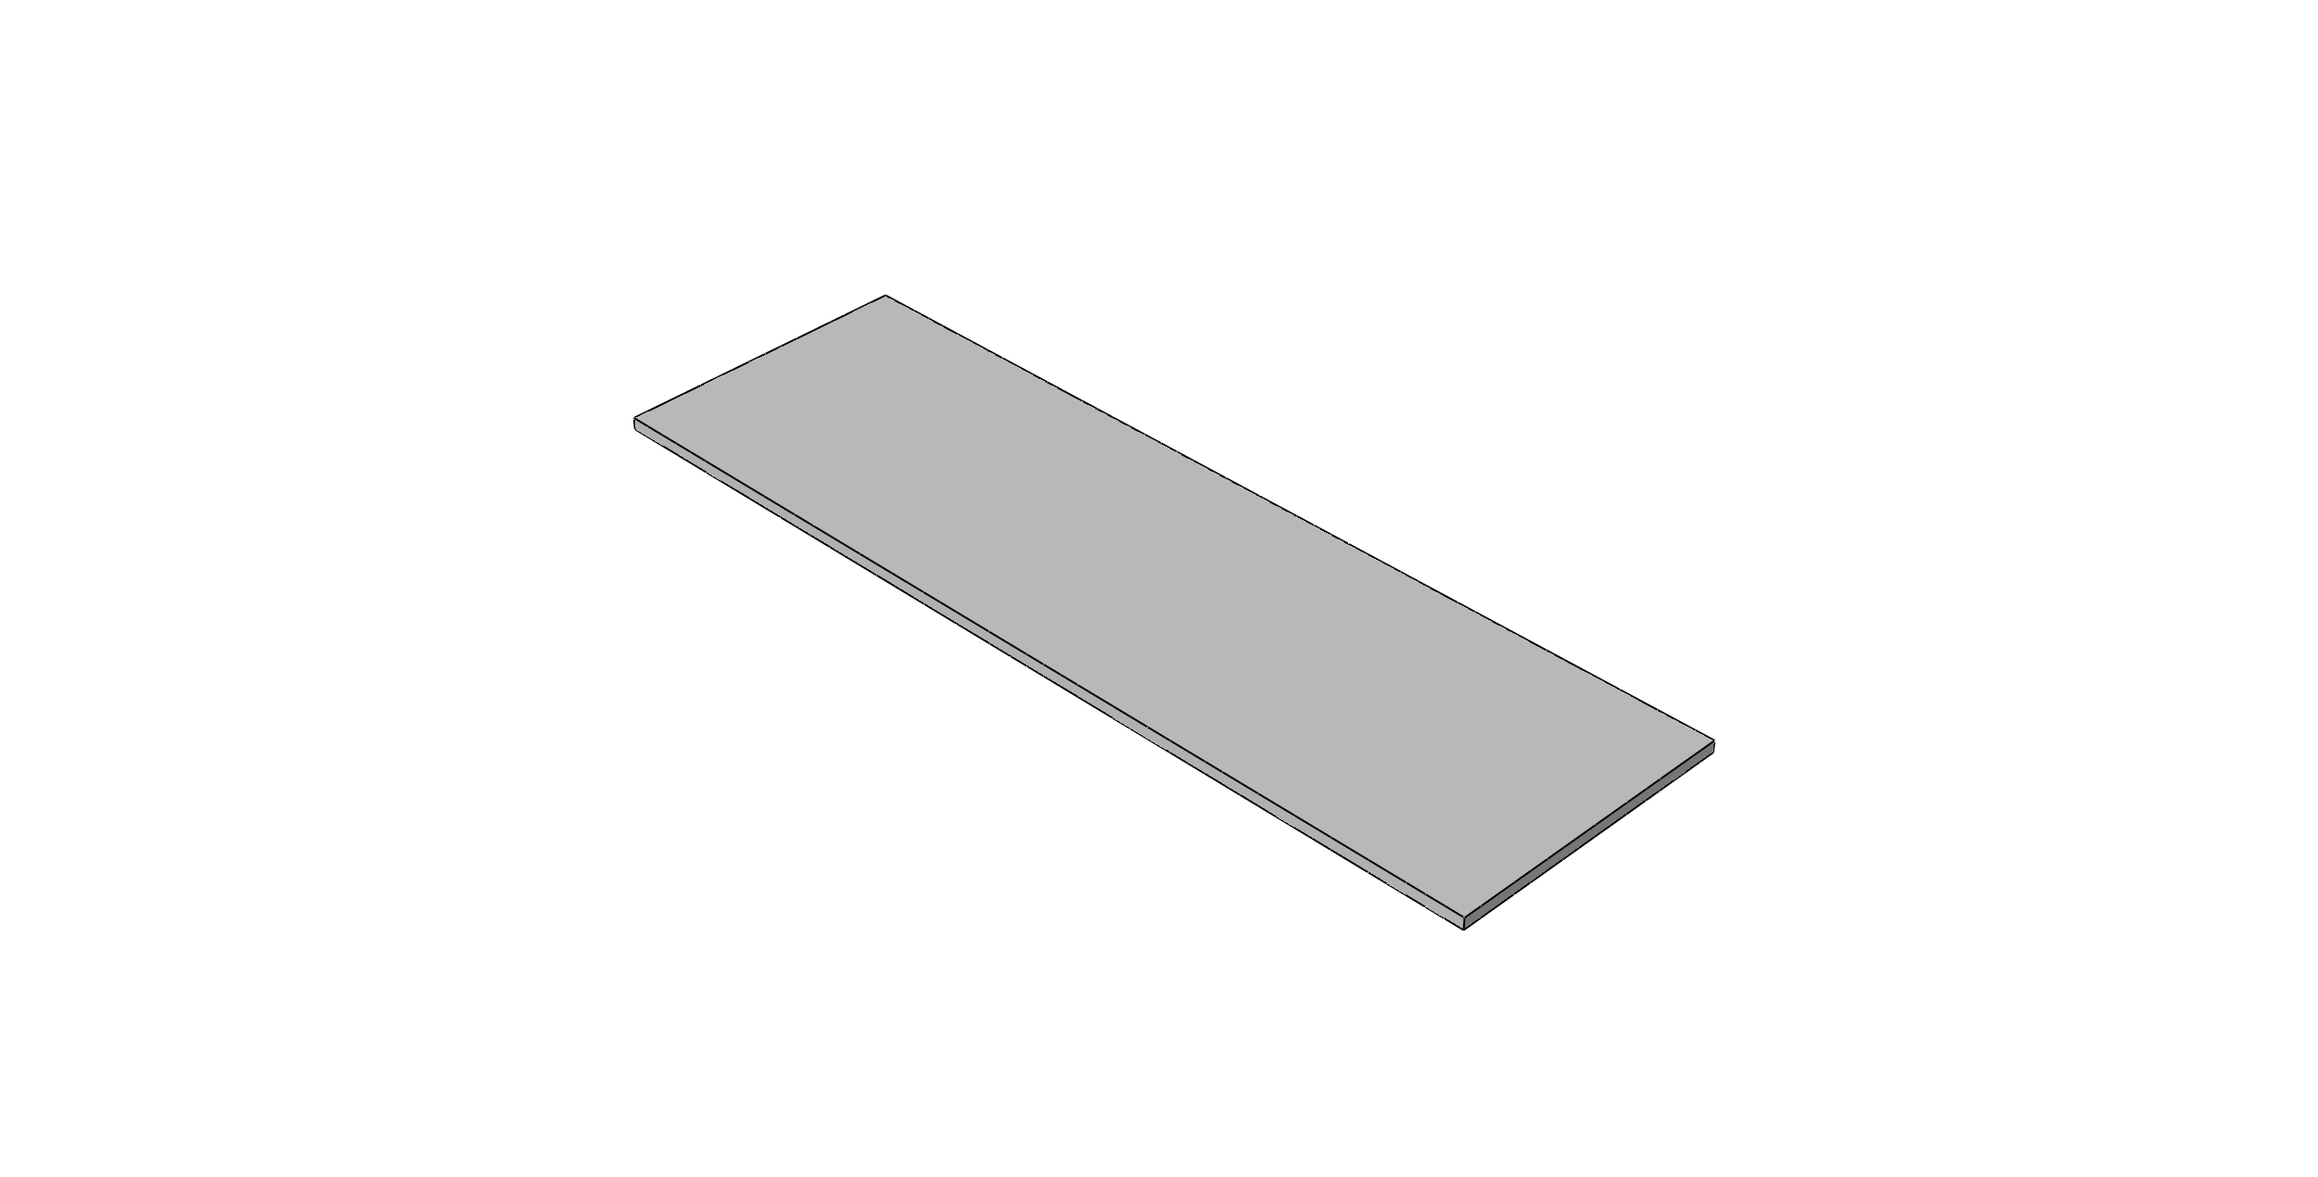
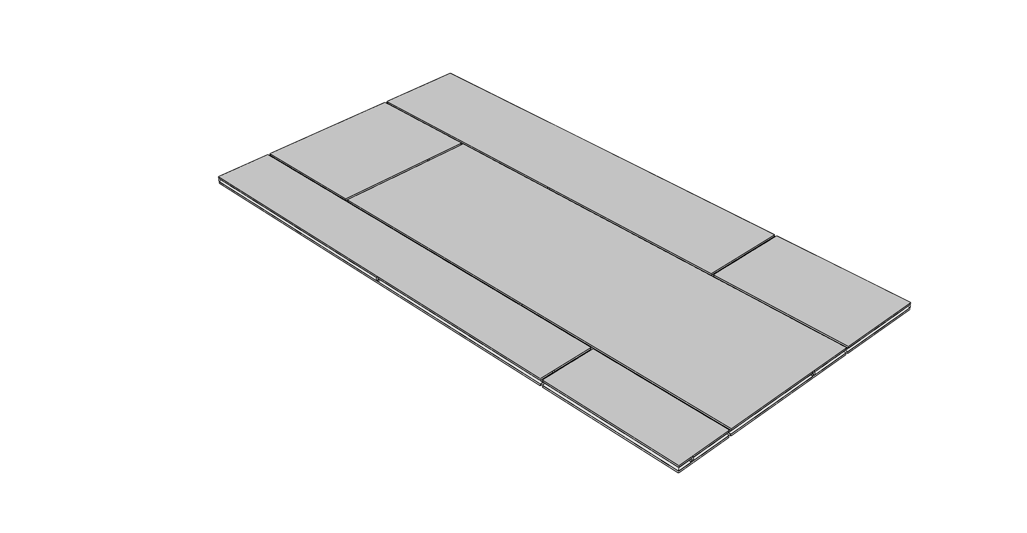
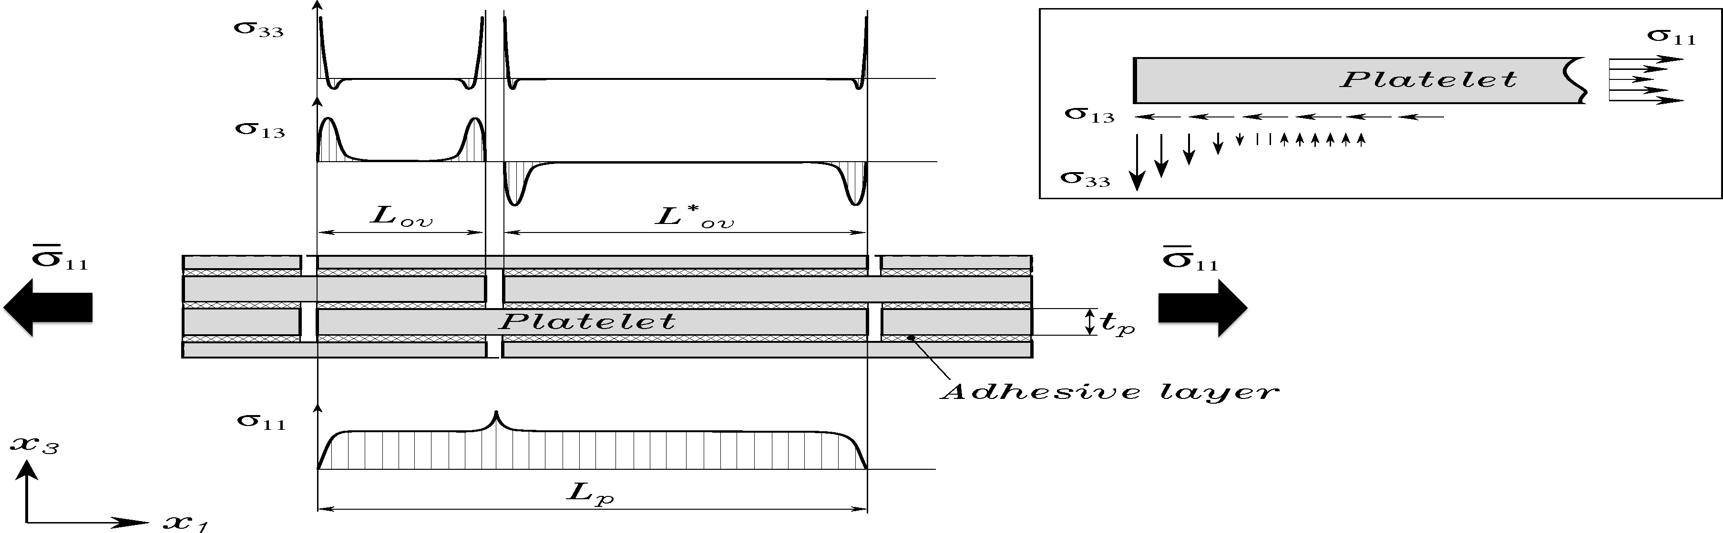
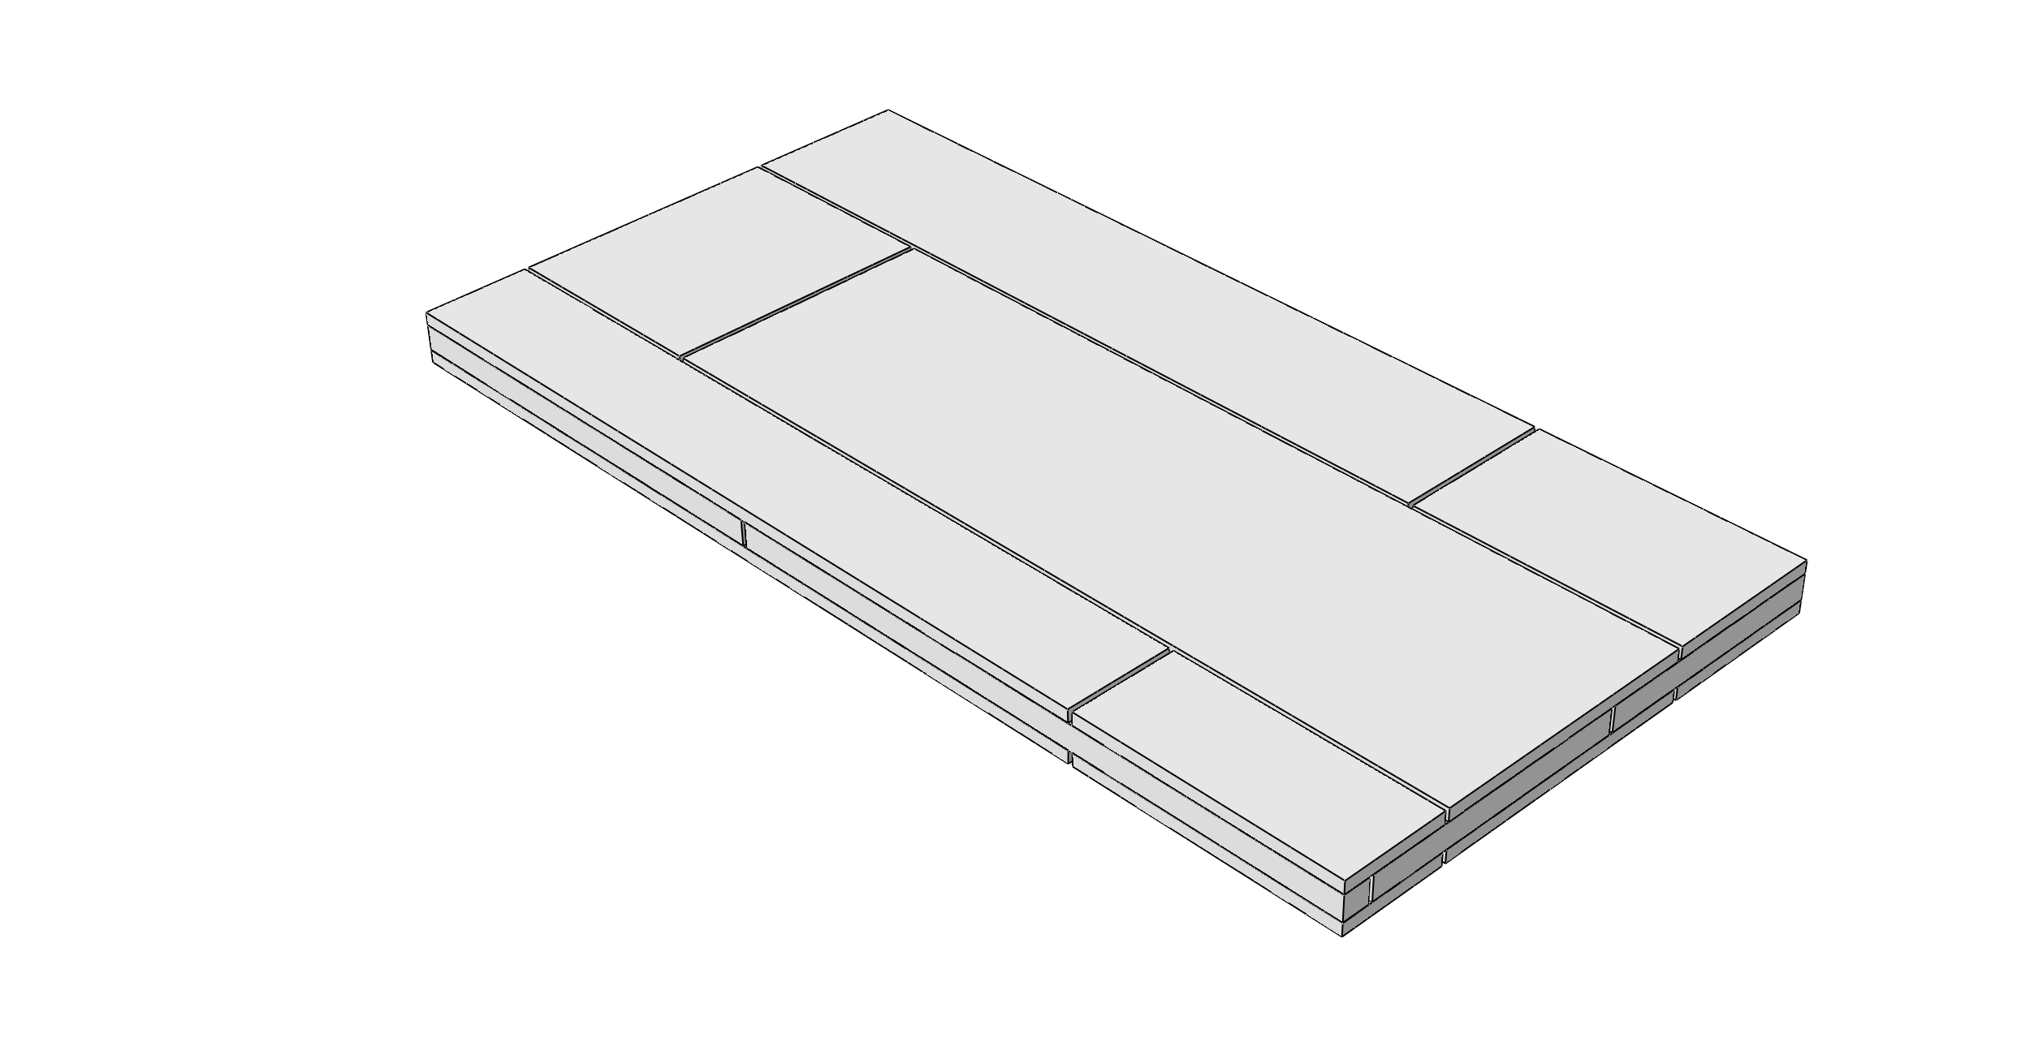


Stress transfer efficiency
& composite system performance
Platelets support more in-plane stress & fracture
Array of Aligned Staggered Platelets
More Efficient
Thinner platelets
x₂
x₃
x₁
x₂
x₃
x₁
$${\overline{ε}}_{11}$$
Stress Transfer
Interlaminar stresses are greater to cause disbonding
Less
Efficient
Thicker platelets
x₂
x₃
x₁
$${\overline{ε}}_{11}$$

Slide 10
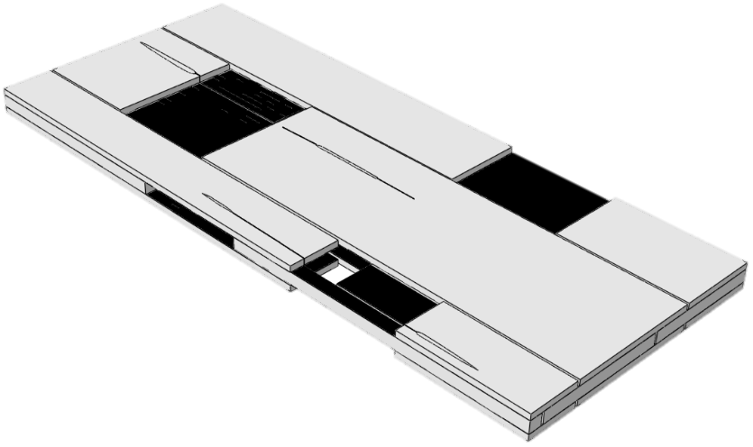
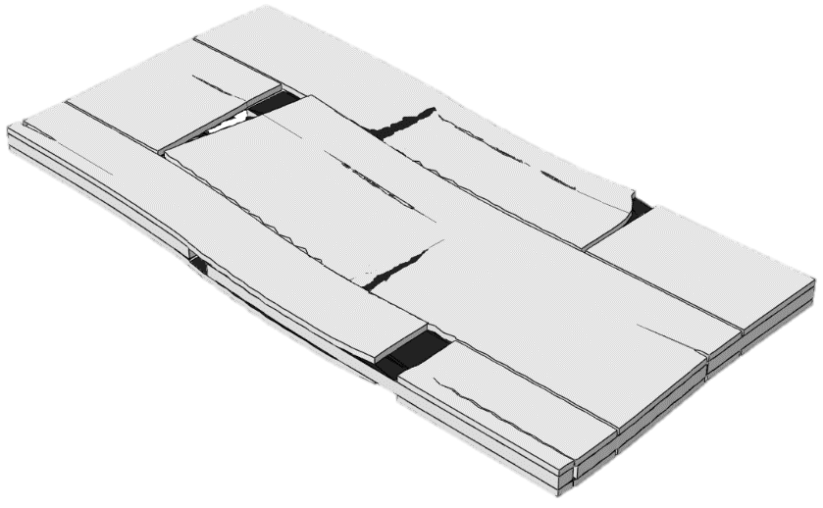
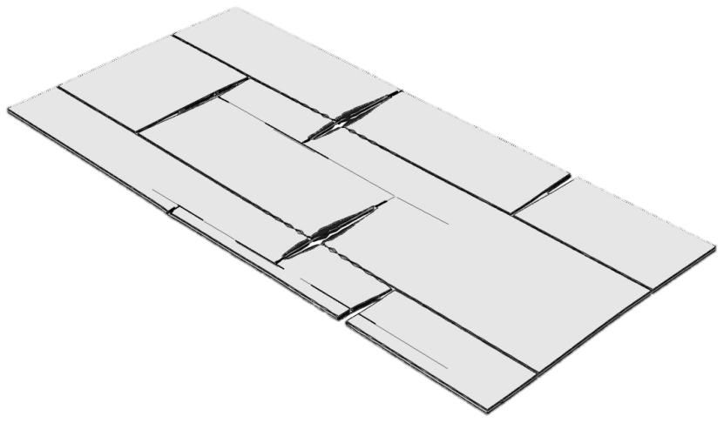
What defines stress transfer efficiency?
Platelet Geometry
Improved Stress Transfer by Platelet Geometry (L_{p}/t_{p} ↑)
Improved Effective Strength of Composite System
Geometrical Arrangement
of Platelets
Improved Stress Transfer by Platelets Arrangement (more overlap length)

Slide 11
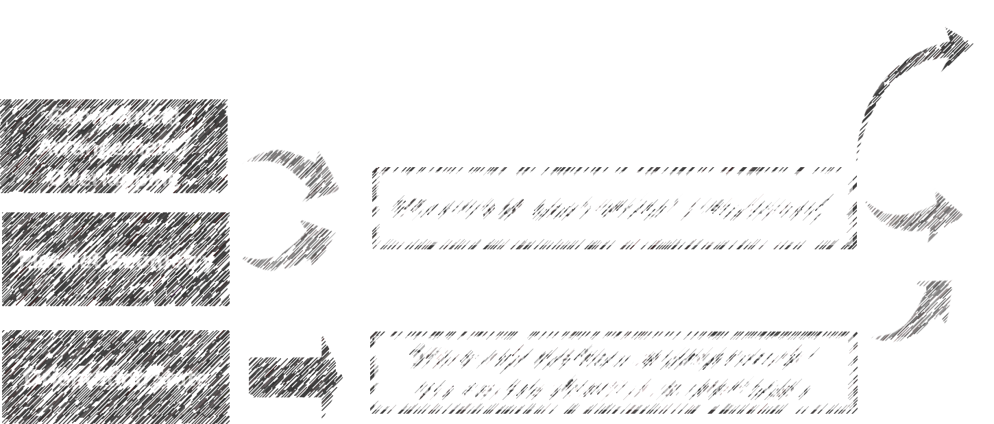
Implications of structure descriptors for composite performance characteristics
Variability of morphology descriptors
Variability
of Effective Properties
Platelets Count
Internal redundancy of composite system
Effective Properties

Slide 12
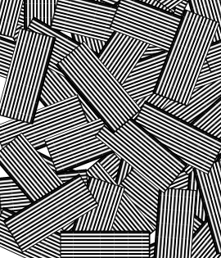
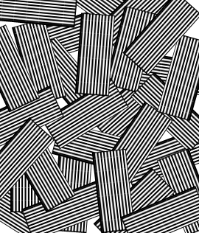
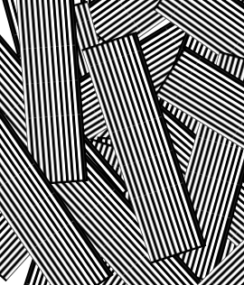
Two ways to vary the platelets count
(stochastic & deterministic systems)
Volume, V₁
Volume, V₂ > V₁
Fixed Volume
Volume, V₁
Platelets Count
by Increasing Composite System Volume
Platelets Count
by Changing Platelet Size
Active/Direct
Passive/Indirect

Slide 13
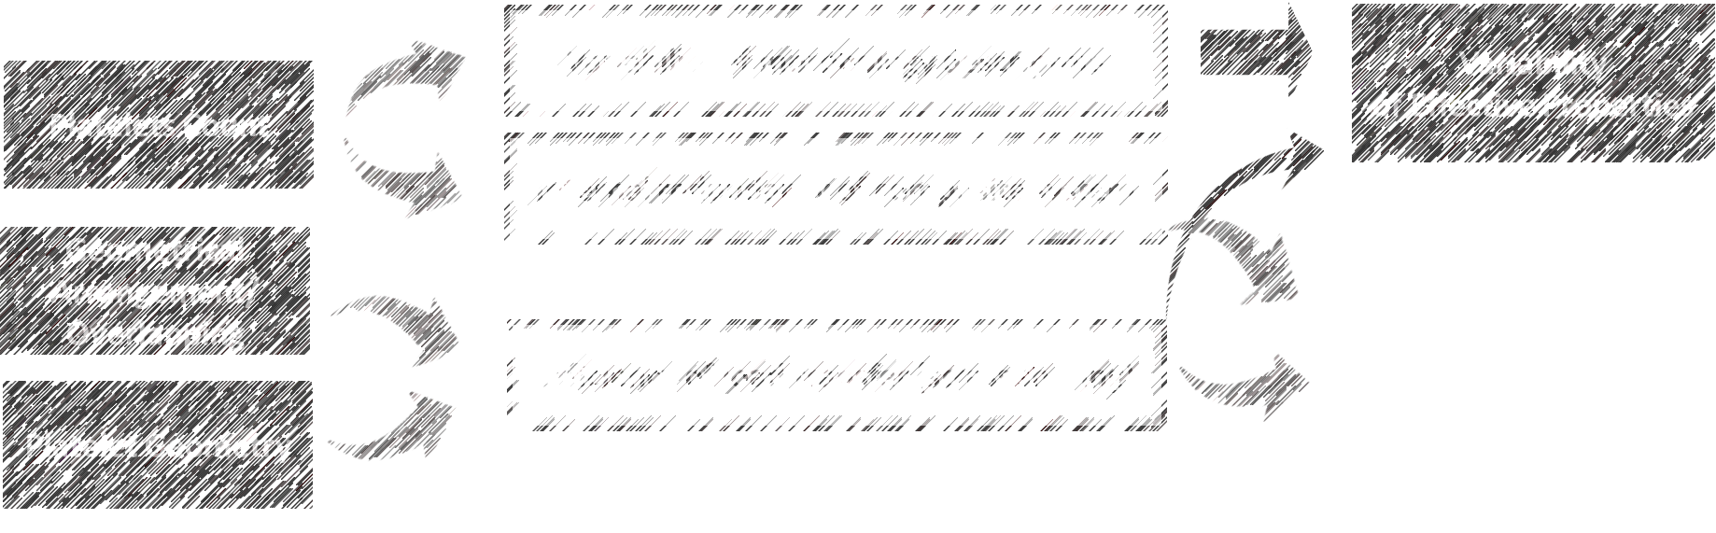
Implications of structure descriptors for composite performance characteristics
Effective Properties
Orientation State
Orthotropic mechanical properties of a platelet are a function of orientation

Slide 14
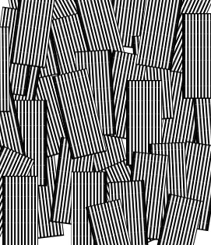
Alignment of platelets is a significant feature of orientation state
x₂
x₂
x₃
x₃
Platelets Alignment
x₁
(with the global x1-direction)
x₁
Active/Direct
Stochastic system: Introduce preferential alignment
Deterministic system: Design/assign orientation state
Influence on
Orientation State
Passive/Indirect
By platelets count in a stochastic system

Slide 15
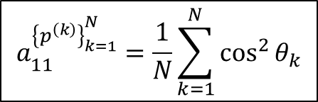


Orientation tensor as an up-scale measure of orientation disorder in a system of many platelets
$$a_{11}^{{\left\{p^{\left(k\right)}\right\}}_{k=1}^{N}}=\frac{1}{N}\sum_{k=1}^{N}{\cos^{2}{θ_{k}}}$$
A convenient large scale descriptor of the orientation state in a composite system containing a large number of misaligned platelets
$$θ_{k}$$
$${\vec{p}}_{k}=\text{"1"}, platelet fiber direction$$
x₁
x₁
x₁
x₁
x₁
x₂
x₂
x₂
x₂
x₂
a₁₁= 1.0
a₁₁= 0.89
a₁₁= 0.53
a₁₁= 0.32
a₁₁= 0.0
Degree of overall alignment
in a system of N platelets

Slide 16
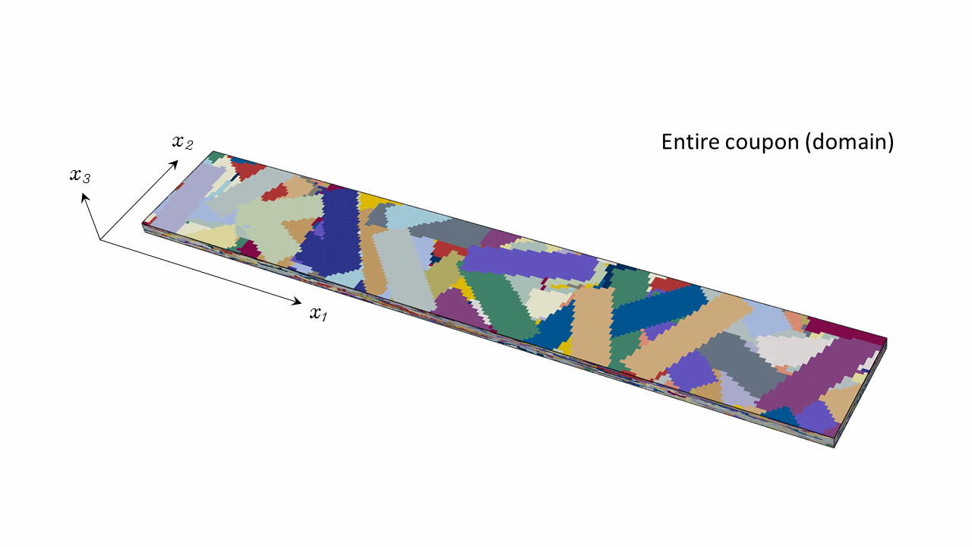


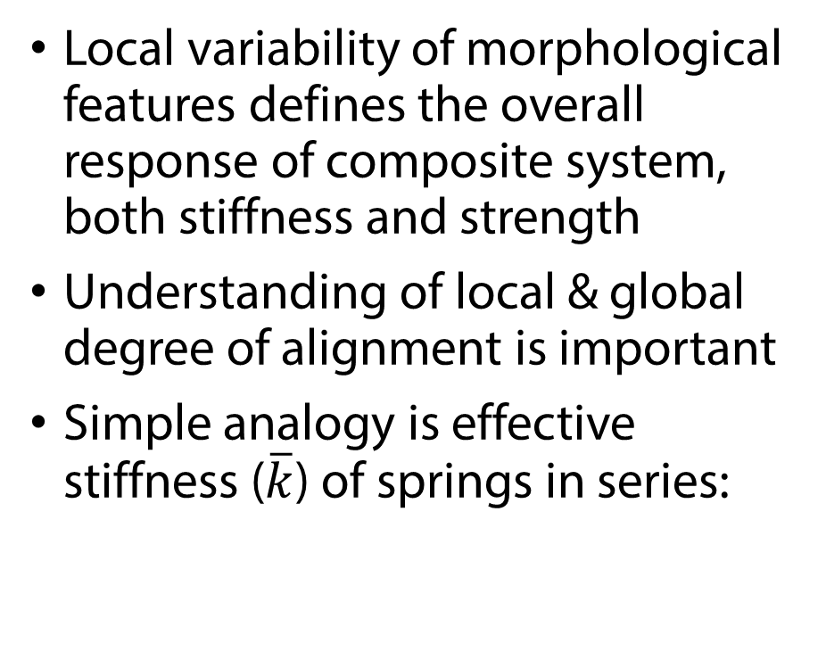


Domain and sub-domains: importance of local effects
Local variability of morphological features defines the overall response of composite system, both stiffness and strength
Understanding of local & global degree of alignment is important
Simple analogy is effective stiffness ($\overline{k}$) of springs in series:
$$\vec{F}$$
k₁
k₂
k₃
k₄
k₅
k₆
$$\vec{F}$$
$$\overline{k}={\left(\sum_{i=1}^{N}{\frac{1}{k_{i}}}\right)}^{−1}$$
Spring 1
Spring 2
Spring 3
Spring 4
Spring 5
Spring 6
x₁

Slide 17
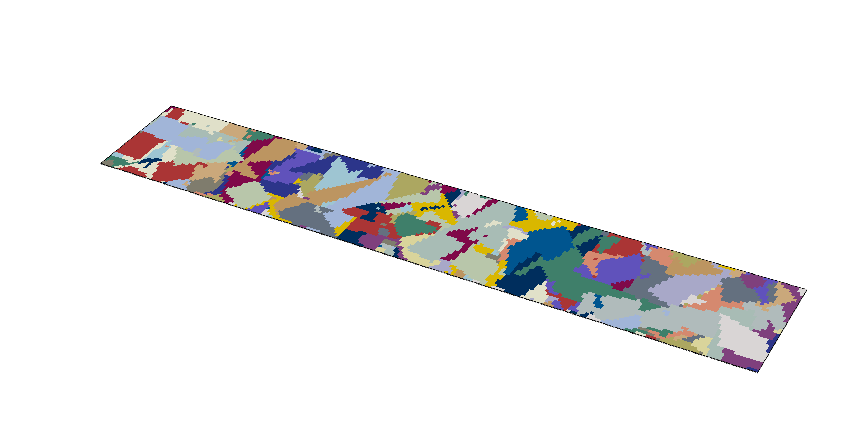
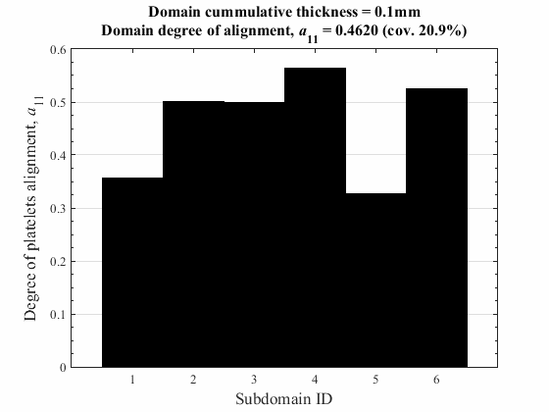
Example of stochastic orientation state build-up with platelets count
Domain occupied by a tensile coupon made of platelets
x₂
x₃
x₁
More platelets added into the system
Domain cumulative thickness
Domain thickness increases
More statistical probability for:
Overall platelets alignment to increase
Orientation state to be more uniform over the entire domain with fewer “weak spots” (reduced intra-coupon orientation variability)
Reduced dissimilarity (variab) of inter-coupons orientation states

Slide 18

ambiguous relationships between morphological descriptors of a complex system
Platelet system internal redundancy
(for both stochastic and deterministic orientation states)
Stress transfer in a platelet system
Platelet size
Other descriptors/characteristics of system morphology
Platelets count in a platelet system
Overlapping between platelets → stress sharing efficiency (stochastic & deterministic)
Platelet Size Effects on
Composite Morphology
Variability of stochastic orientation state
t_{p}= var
w_{p}= var
L_{p}= var

Slide 19
Computational modeling of progressive damage in a stochastic platelet composite system

Slide 20

Fundamental premises for computational modeling of damaged deformation
Multi-directional discontinuous platelet composite system is modeled as continuum in (x₁,x₂,x₃) space with sub-domains assigned local coordinate systems (1,2,3) to represent stacked misaligned platelets.
Progressive failure analysis based on stiffness reduction scheme and smeared crack approach, is a tool to model the damaged deformation
Constitutive tensor of a platelet is 3D-stress/3D-damage stiffness matrix
w_{p}
$$\left\{\begin{matrix}\begin{matrix}σ_{11} \\ σ_{22} \\ σ_{33}\end{matrix} \\ \begin{matrix}σ_{12} \\ σ_{13} \\ σ_{23}\end{matrix}\end{matrix}\right\}=C\left(d\right)\left\{\begin{matrix}\begin{matrix}ε_{11} \\ ε_{22} \\ ε_{33}\end{matrix} \\ \begin{matrix}2ε_{12} \\ 2ε_{13} \\ {2ε}_{23}\end{matrix}\end{matrix}\right\}$$
x₂
L_{p}
x₃
2
σ₃₃
2
σ₁₃
σ₂₃
σ₂₂
σ₁₂
x₁
σ₁₁
1
1

Slide 21
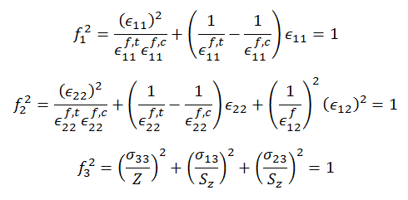
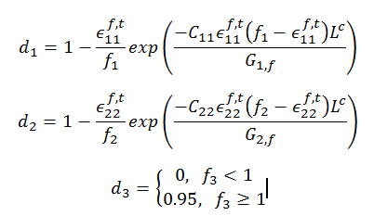
Continuum damage mechanics based material model of a platelet
Damaged constitutive tensor:
Damage initiation criteria:
Damage evolution laws:

Slide 22
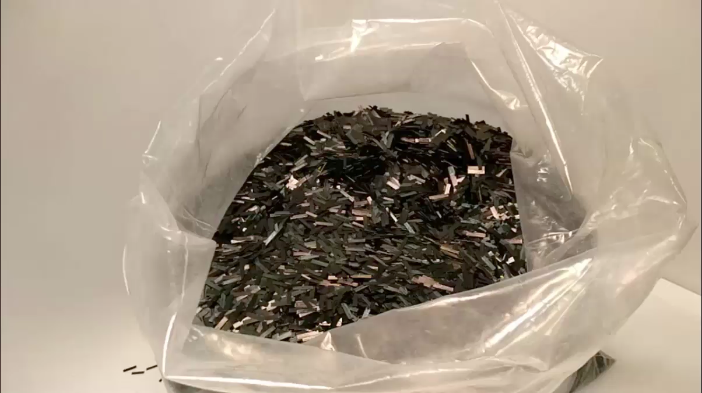
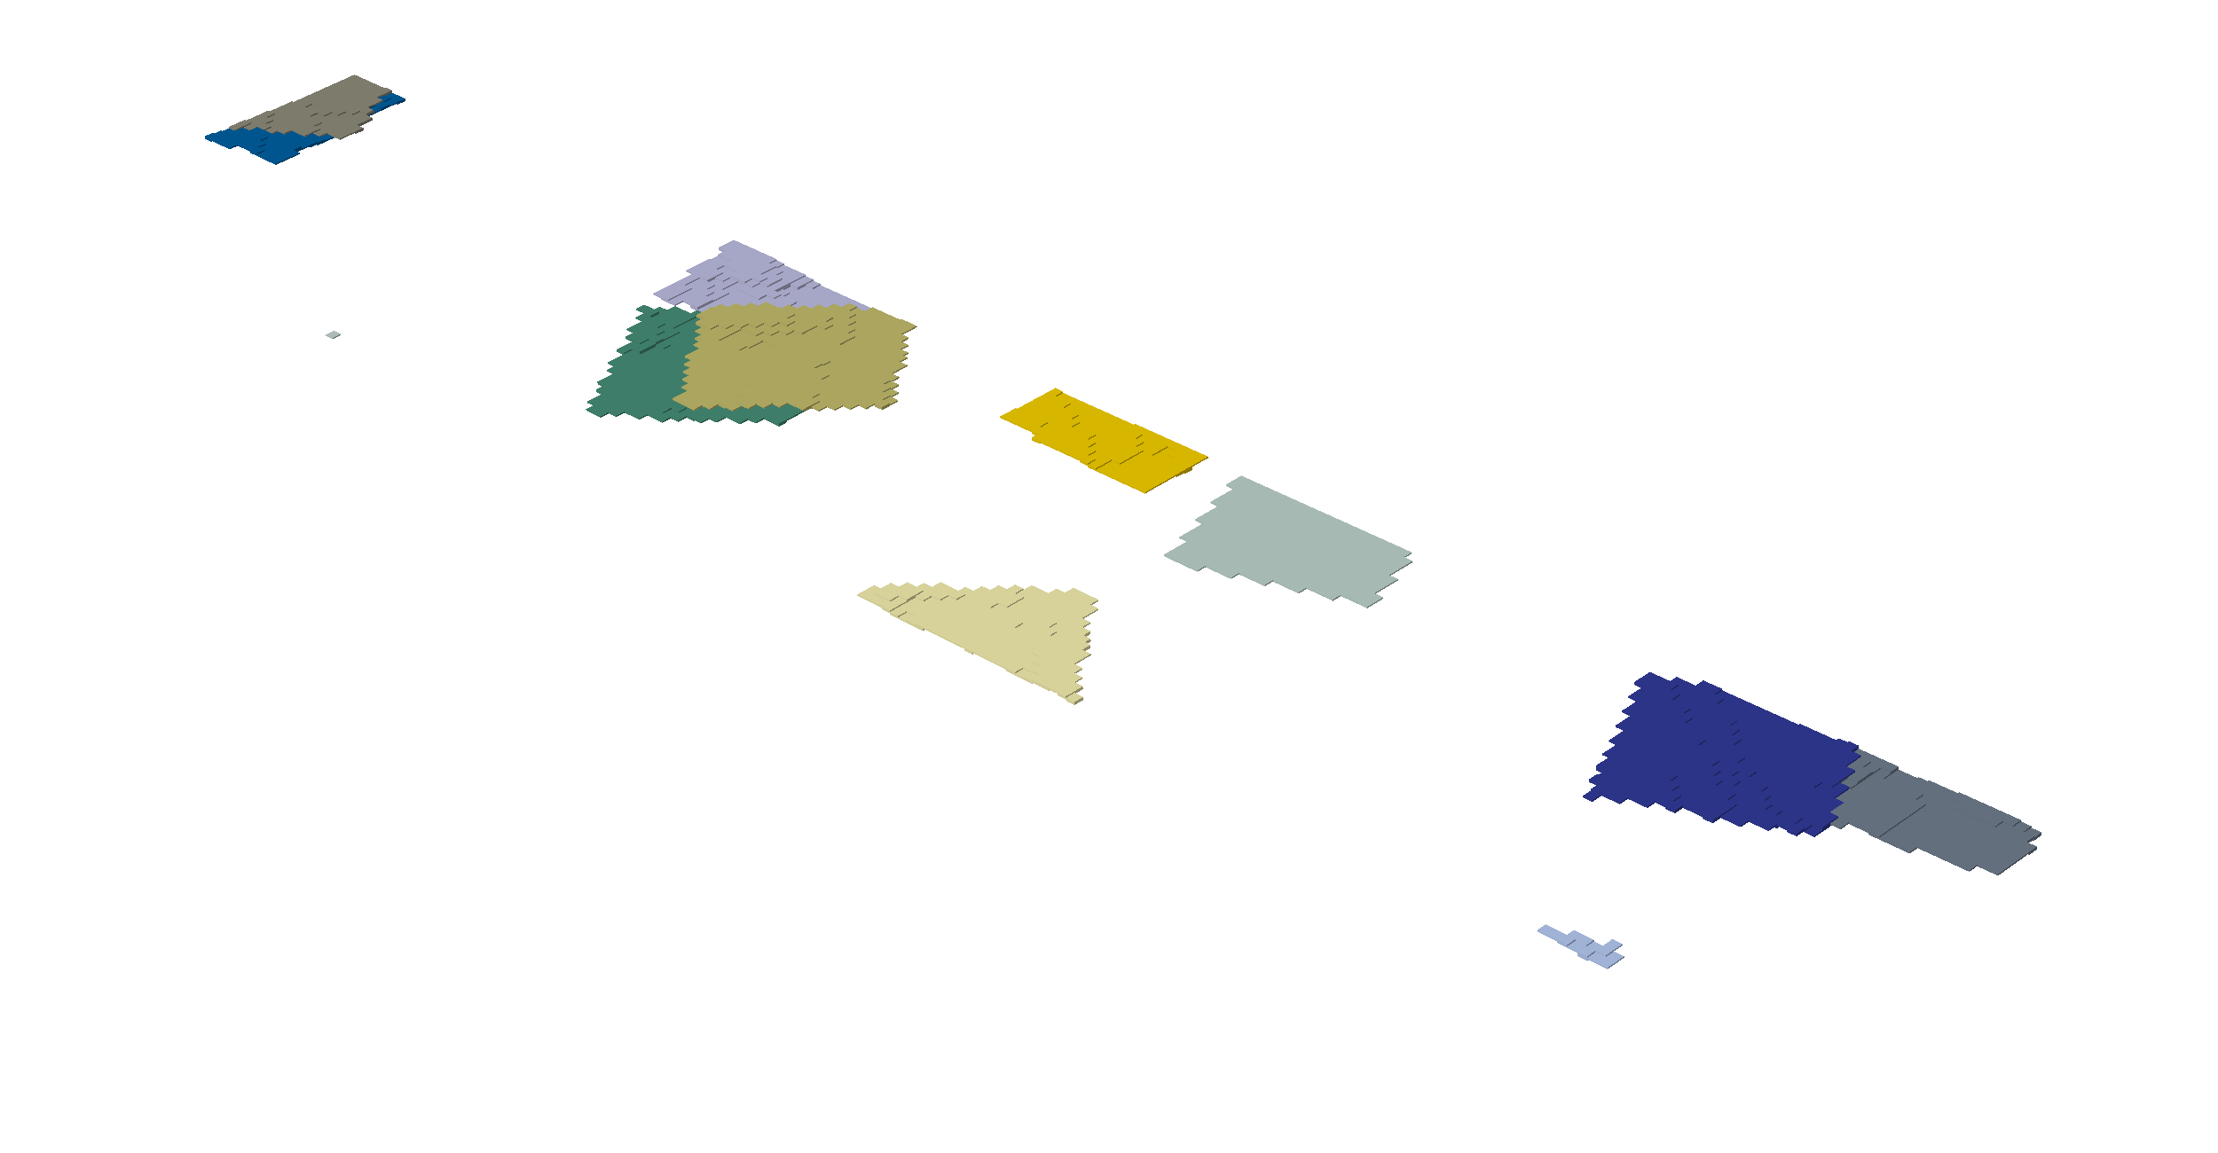

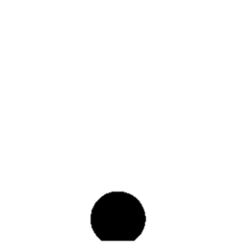
Algorithm in image of reality: physical vs model stochastic morphology
Uncontrolled Stochastic Morphology
from Manufacturing
Virtually Generated Meso-Scale Morphology
“Pseudo-Random”
True stochastic nature is approximated by an algorithm, operated on a “pseudo-random” number generation after a given probability distribution function.
  Virtual platelets are placed sequentially by generating the center points and an angle according to an orientation distribution function

Slide 23

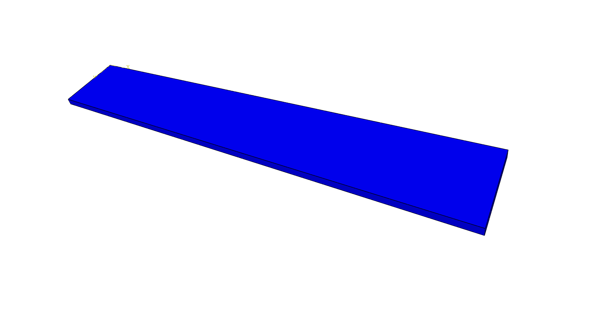
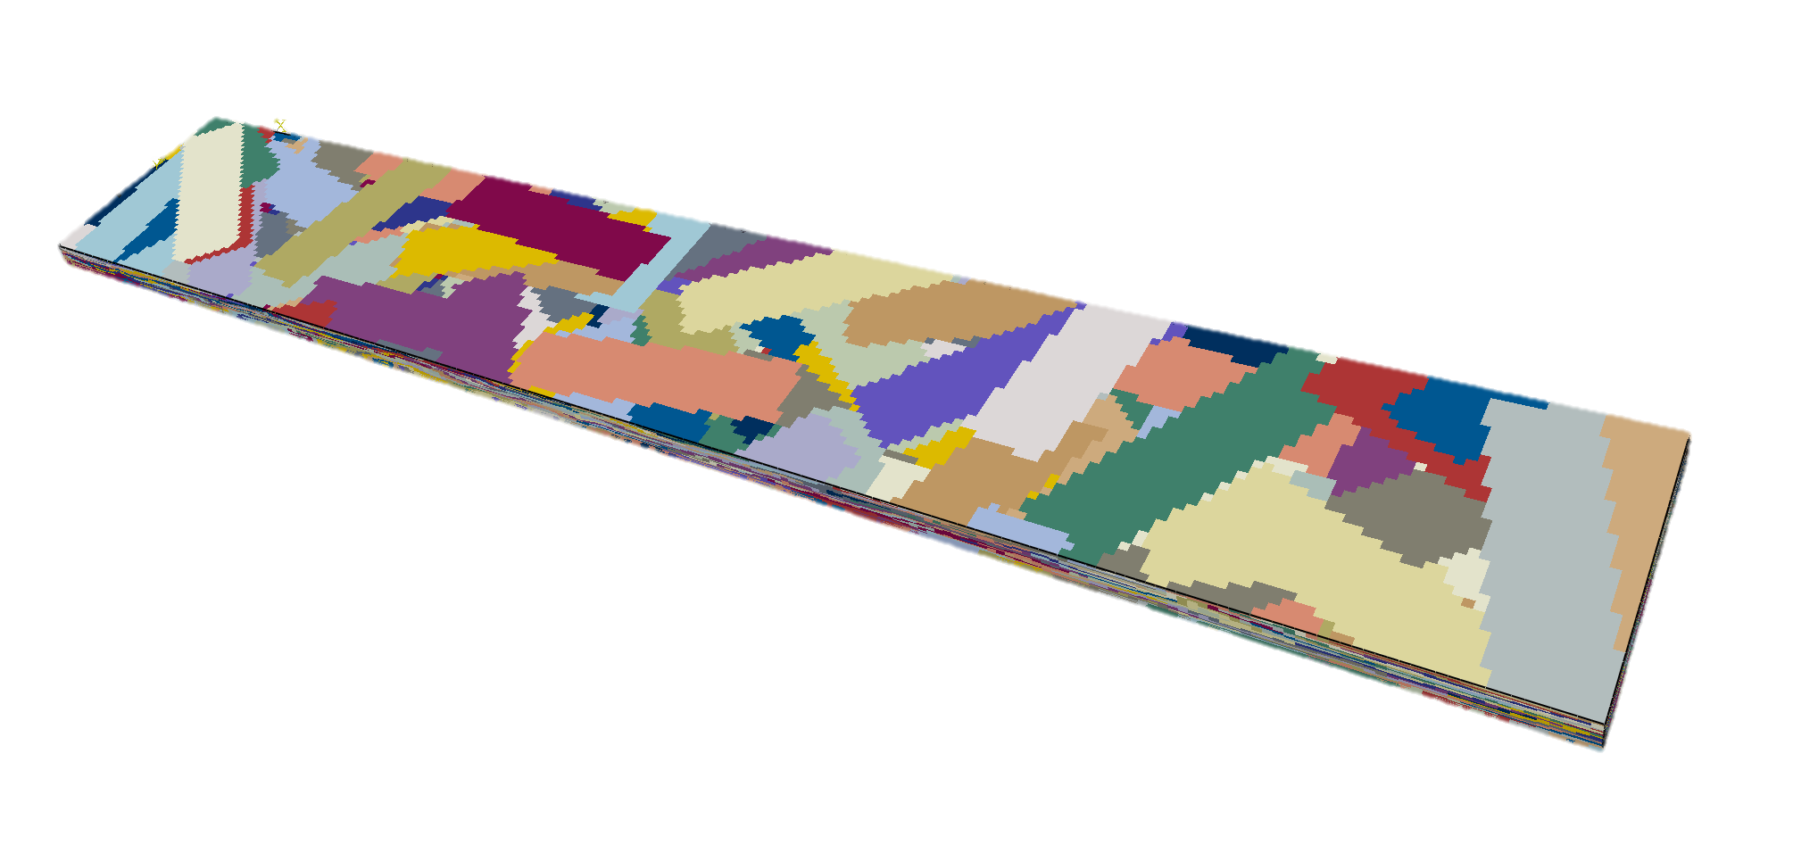
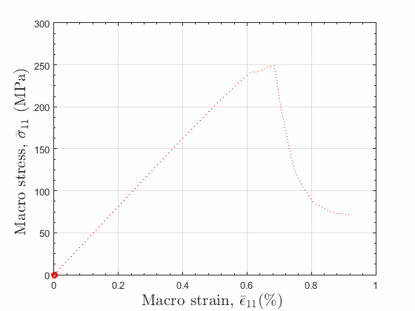

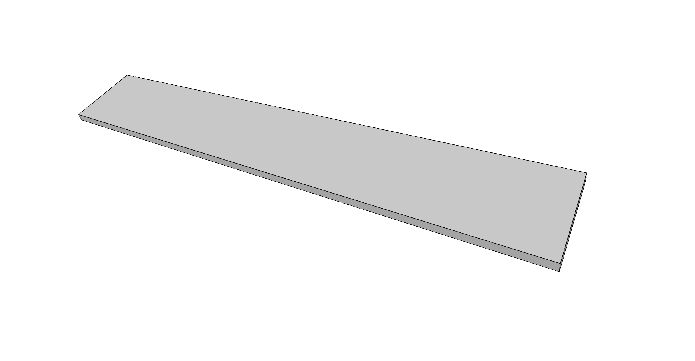


demonstration
$$ε_{11}\left(x_{1},x_{2}{,x}_{3}\right)$$
$\left(\%\right)$
0
0.4
0.8
1.2
x₂
x₁
x₃
Damage index
0
1
x₂
x₁
x₃
$${\overline{σ}}_{11}\left({\overline{ε}}_{11}\right)$$

Slide 24
structure-property relationship in prepreg platelet systems

Slide 25
Influential factors for composite effective properties
(stochastic system)
w_{p}
2
Effect of platelet size, length (L_{p}) and thickness (t_{p})
Effect of variability of stochastic orientation state caused by platelets count:
  Scaling of composite effective properties with composite thickness (t)
Effect of the platelets alignment on tensile properties of a composite system
L_{p}
t_{p}
t_{p}= var
w_{p}= var
1
L_{p}= var
x₂
x₃
t
x₁

Slide 26
Platelets count (fixed platelet size)
&
Stochastic orientation state
Platelet system with a stochastic orientation state
Fewer platelets/orientation:
  More orientation dissimilarity between volumes
  More local orientation dissimilarity within a volume
More platelets/orient’s increases the probability of having more alignment
There is a limited number of platelets and orientations within a given volume
t₂ > t₁
t₁
More Platelets → More Orientations
Fewer Platelets → Fewer orientations
Platelets Count

Slide 27
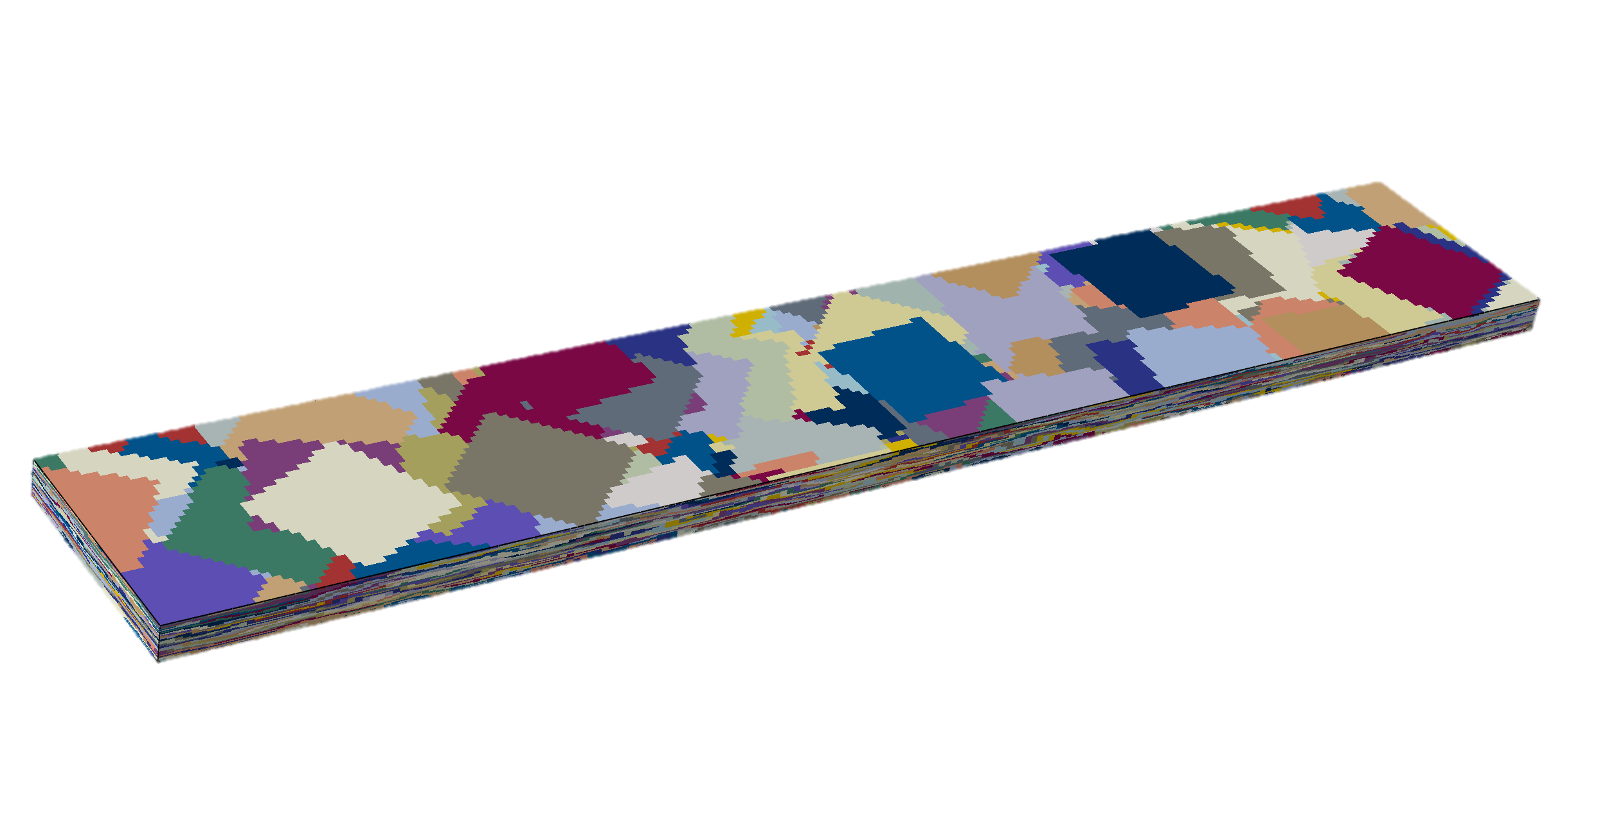
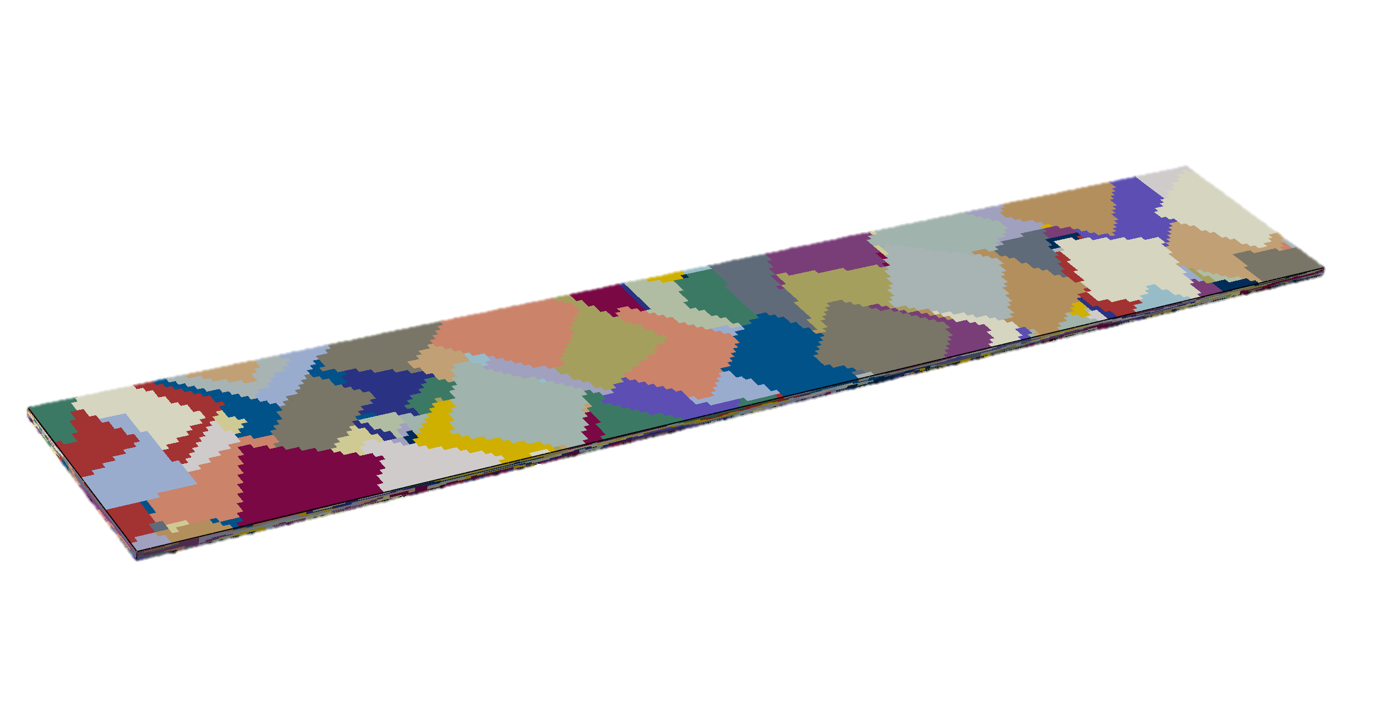
Distribution of local platelets alignment as function of coupon thickness (virtual, 2D-random)
Less intra-coupon variability of platelets alignment
Less inter-coupon variability of platelets alignment
Coupon thickness (mm) | Avg. platelets/coupon
1.0 | 337
3.6 | 949
x₁
3.6mm (0.142in)
25.4mm (1in)
x₃
x₂
1.0mm (0.039in)
152.4mm (6in)
0.5x0.5in platelets

Slide 28
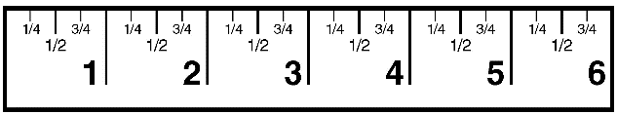

coupon thickness effect on tensile properties (stochastic system): experimental & simulated
$${\overline{ε}}_{11}$$
0.5x0.5in platelets
L
Experimental
Simulation
(3D-stress/3D-damage)
x₁
x₃
x₂
w
t

Slide 29
Effect of increased platelet length on stiffness & strength of stochastic system
x₂
x₃
Increased Variability
Platelets Count
x₁
Improved Performance
Platelets Length, L_{p} (t_{p}=const)
Efficiency of Stress Sharing

Slide 30
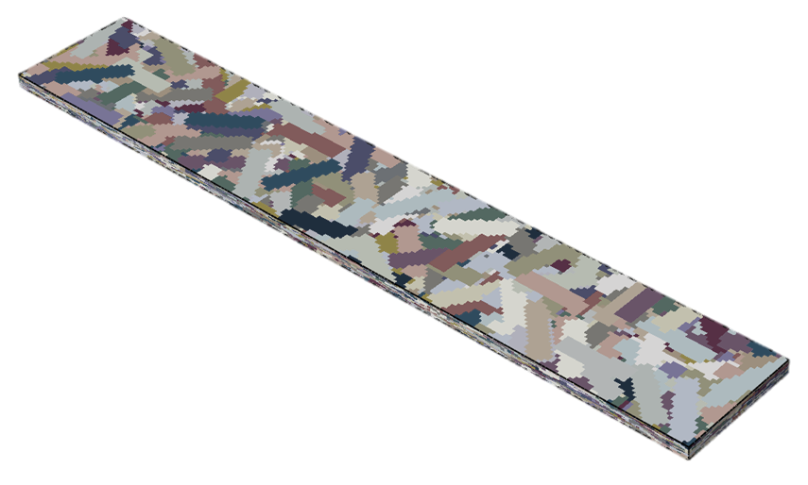
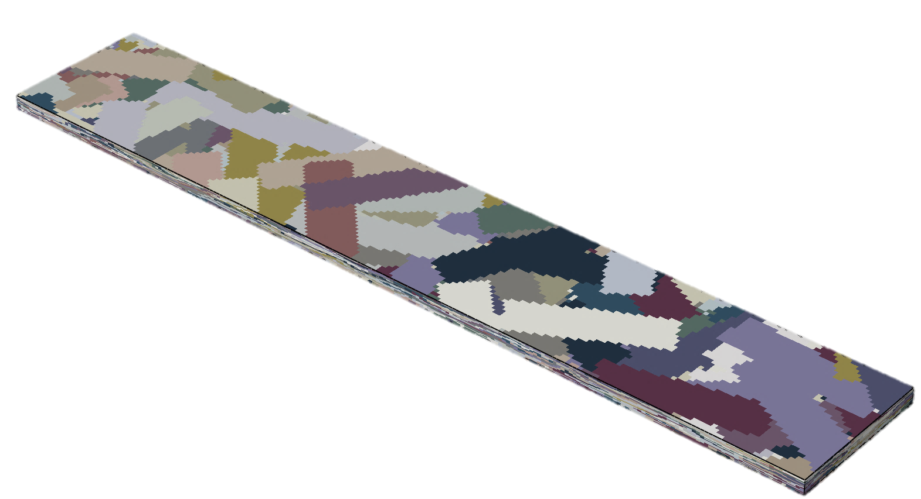
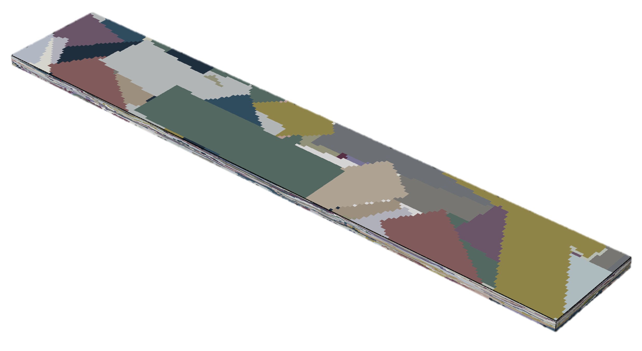
Case-study: platelet length effect on performance characteristics of a stochastic system
L_{p} x w_{p} = 12.7 x 3.175mm
(avg. 1,685 platelets/coupon)
L_{p} x w_{p} = 25.4 x 6.35mm
(avg. 638 platelets/coupon)
L_{p} x w_{p} = 50.8 x 12.7mm
(avg. 291 platelets/coupon)
2.5mm (0.098in)
151.9 mm (~6in)
x₂
x₁
x₃
25.2mm (~1in)
Virtual tensile coupons of platelets / 5 individually generated (“2D-random”) and 5 extracted from a plaque (“2D-random”); Coupon thickness = 2.5mm;
Platelets: t_{p}=0.1mm; Platelet length (L_{p}) is varied as 0.5in, 1.0in, 2.0in (L_{p}/w_{p}=4)

Slide 31
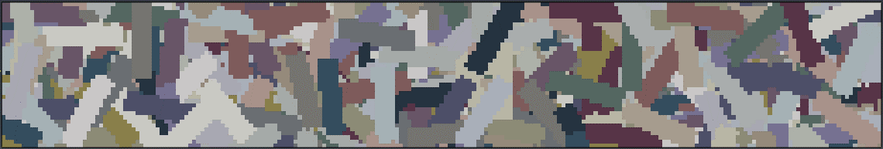
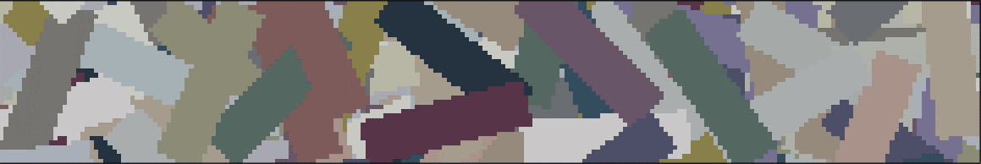

simulated Platelet length effect on stiffness & strength in a stochastic system
Added efficiency
Increased variability

Slide 32
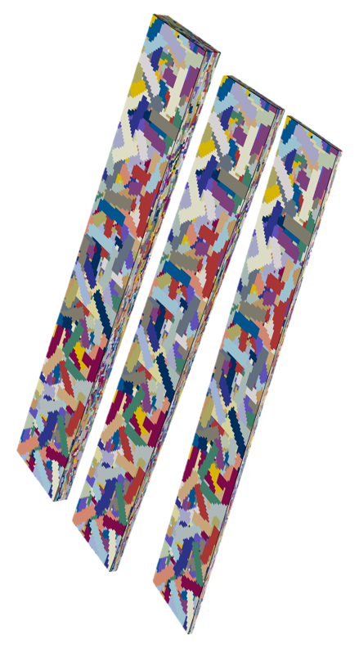
Platelet length-to-thickness ratio
& efficiency of stress transfer (stochastic system)
“Shrinking”/”swelling” a virtual coupon with preserved morphology by varying platelet thickness
Morphology variability effect on composite stiffness/strength from platelet size effect is separated. Increased platelet length-to-thickness ratio is responsible for improved composite properties

Slide 33
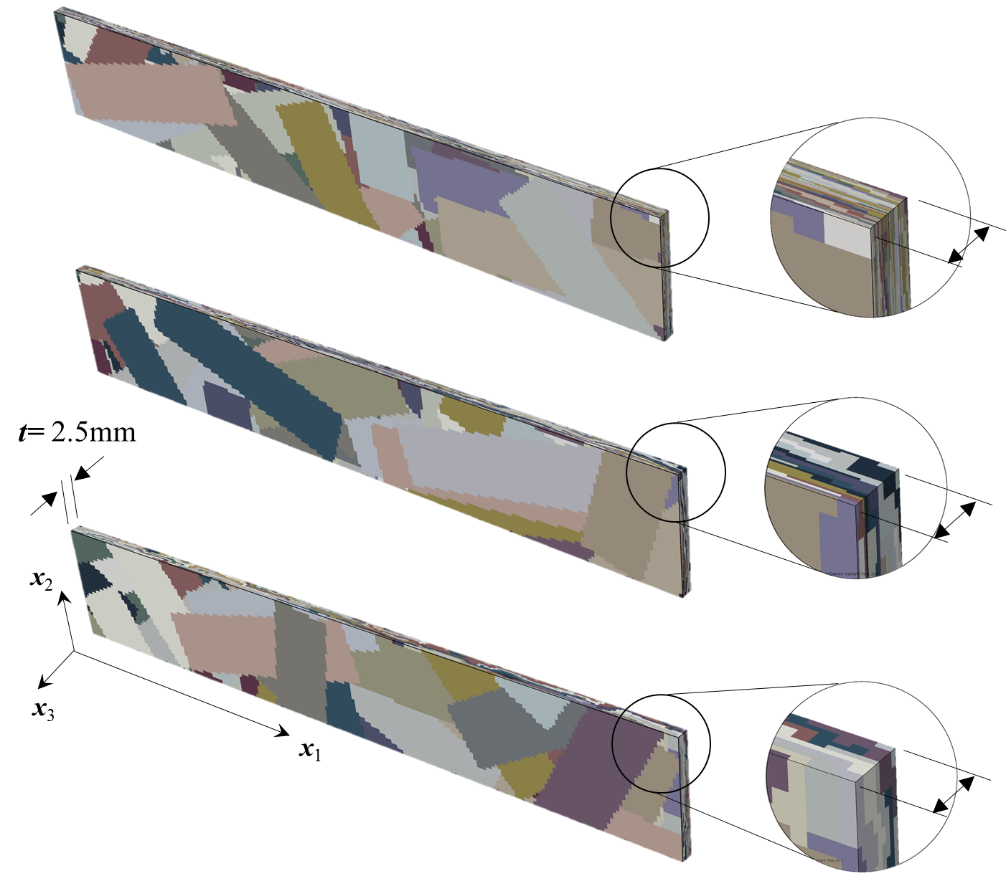
Effect of using thinner platelets (thinner tape): concept
2.5mm-thick tensile coupons;
L_{p}=2in (L_{p}/w_{p}=4);
Platelet thickness (t_{p}) :
  t_{p}= 0.050 mm
  t_{p}= 0.100 mm
  t_{p}= 0.250 mm
Virtual tensile coupons were individually generated by 2D-random orientation tensor
t=50(t_{p});
t_{p}=50μm
Stress Transfer Efficiency
Platelets Count
Platelet Thickness
t=25(t_{p});
t_{p}=100μm
t=10(t_{p});
t_{p}=250μm

Slide 34
Effect of using thinner platelets (thinner tape): analysis results
Thinner platelets
Thicker platelets
Added efficiency
Reduced variability

Slide 35

Effect of platelets alignment on effective tensile properties: experimental (narrow platelet)
$${\overline{ε}}_{11}$$
L
x₂
x₂
w
t
x₃
x₃
1.5-mm thick tensile coupons with enhanced alignment were manufactured, platelet in-plane angle = -10°..10°
x₁
Enhanced Alignment
x₁

Slide 36
improved performance with increased platelets alignment (stochastic system): analysis
x₂
x₁
x₂
x₃
x₃
x₂
Degree of platelets alignment, a₁₁
x₁
x₁

Slide 37
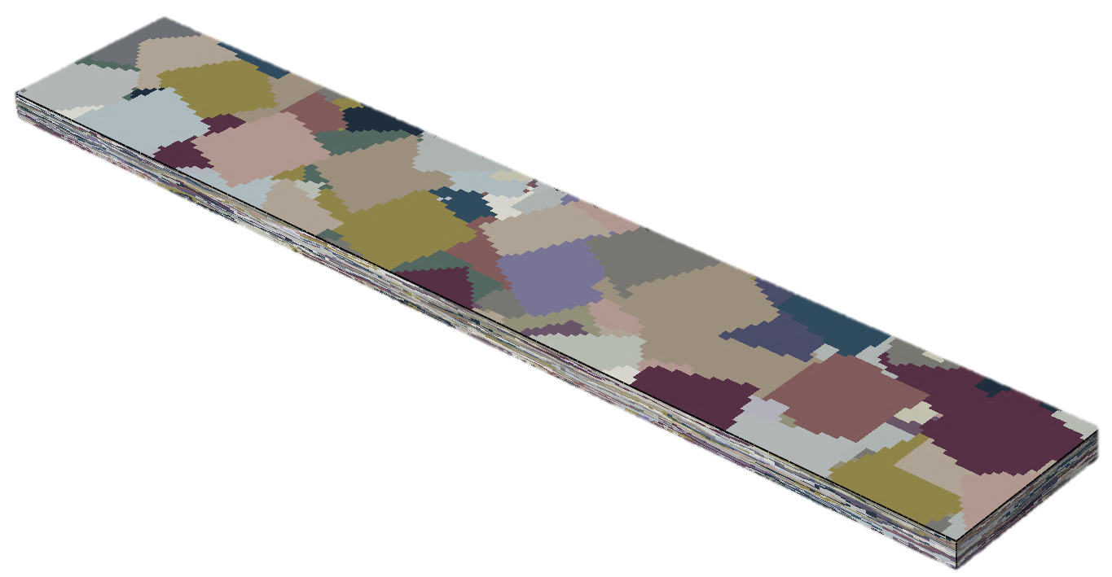
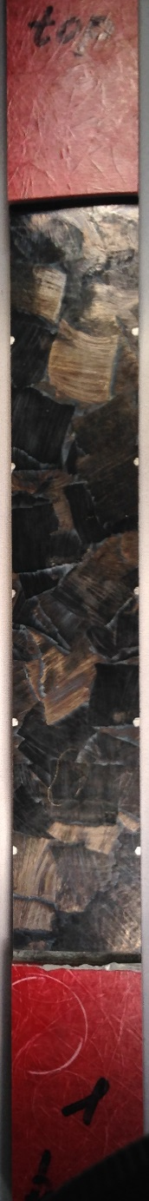
Modeled variability from virtual characterization
(stochastic system)
Global (all coupon) a₁₁= 0.45 – 0.55
Enforcing inter-coupon variability of orientation state by modifying the global degree of alignment allows to more realistically model the morphology caused effective composite properties

Slide 38
Main observations in prepreg platelet systems with stochastic orientation state
w_{p}
The strength of a composite increases with platelet length for a constant thickness (of tape and tensile coupon)
Longer platelets provide for increased variability in effective properties
Thinner tape provides for reduced variability and increased averages of effective properties
Effective properties depend on coupon thickness
2
L_{p}
t_{p}
1
Supported by experimental observations of different research groups
x₂
x₃
t
x₁

